Slide 1
MULTI NODE CLUSTER SETUP
PROJECT TITLE
Using
Apache Spark
Presented By
Bappi Kumar
1611176112

Slide 2
What will we learn today???
Objectives
Methodology
Definition of Cluster
Ways of Cluster
Types of Cluster
Hardware and Software Components
Selected Cluster
Definition and Purposes
1 of <number>1

Slide 3

Supported Language
Spark Features
Components of Apache Spark
Spark Architecture
Applications Of Spark
Spark Use Case
Goals
2 of 21

Slide 4

Objectives
There is no place where Big Data does not exist. The curiosity about Big Data has been soaring in the past few years.
Now, What is Big Data ?
Big Data refers to the large amounts of data that is pouring in from various data sources and has different formats. This various types of data should have to process, analysis and store for the purposes of easily accessing.
3 of 21

Slide 5




Methodology
a. 100% operational
b. Never failing
c. Available continuously
d. Redundant power supply
e. Multiple network card
f. HA Cluster
4 of 21

Slide 6
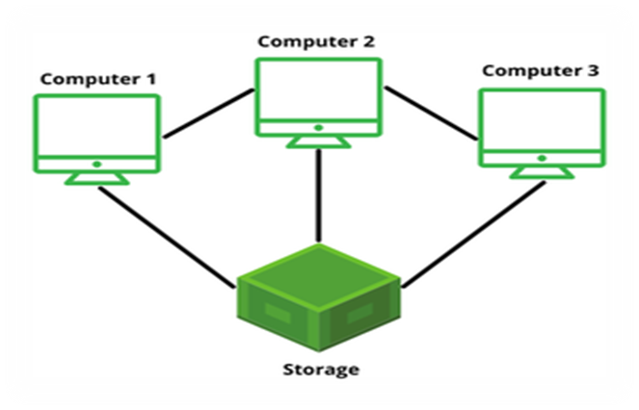
Definition of Cluster
Group of servers and resources
Acts like a single system
Enable high availability
Load balancing and parallel processing
Provides solutions for redundant operations
5 of 21

Slide 7

Ways of Cluster
Two ways of Cluster,
1. Manual Cluster
2. Automatic Cluster
6 of 21

Slide 8
Types of Cluster
Four major types of clusters for our need,
a. High availability(Active - Passive)
b. Load Balancing(Active - Active)
c. High performance
d. Storage
7 of 21

Slide 9
Selected Cluster
Cluster can be,
a. Data Torrent
b. Hadoop Cluster
c. Apache Strom Cluster
d. Apache Spark Cluster
We will working using Apache Spark for its various benefits and different purposes.
8 of 21

Slide 10
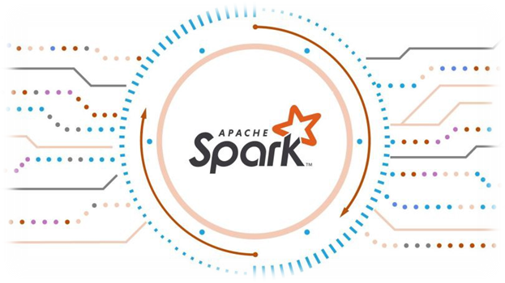
SW Components
OS like (Linux, Zorin OS, Windows)
Default Java
SSH Setup & Key Generation
Update Apache Sark installation
9 of 21

Slide 11
What is Apache Spark???
Open source data processing engine
Stores and Processes data in real time
Creates various clusters
Using a very simple programming constructs
10 of 21

Slide 12
Purposes of Apache Spark
Big Data Analysis
Query, Analyze and Transform Data
Performs both batch & real-time processing
Fewer lines of code
Faster than Map Reduces
Developers and Data Scientists incorporate Spark in to their apps
11 of 21

Slide 13
Supported Languages
R
Python
Java
Scala
12 of 21

Slide 14
Apache Spark Features
Fast Processing
In Memory Computing
Flexible
Fault Tolerance
Better Analytics
13 of 21

Slide 15
Components of Apache Spark
Spark Core
Spark SQL
Spark Streaming
ML lib
Graph X
14 of 21

Slide 16

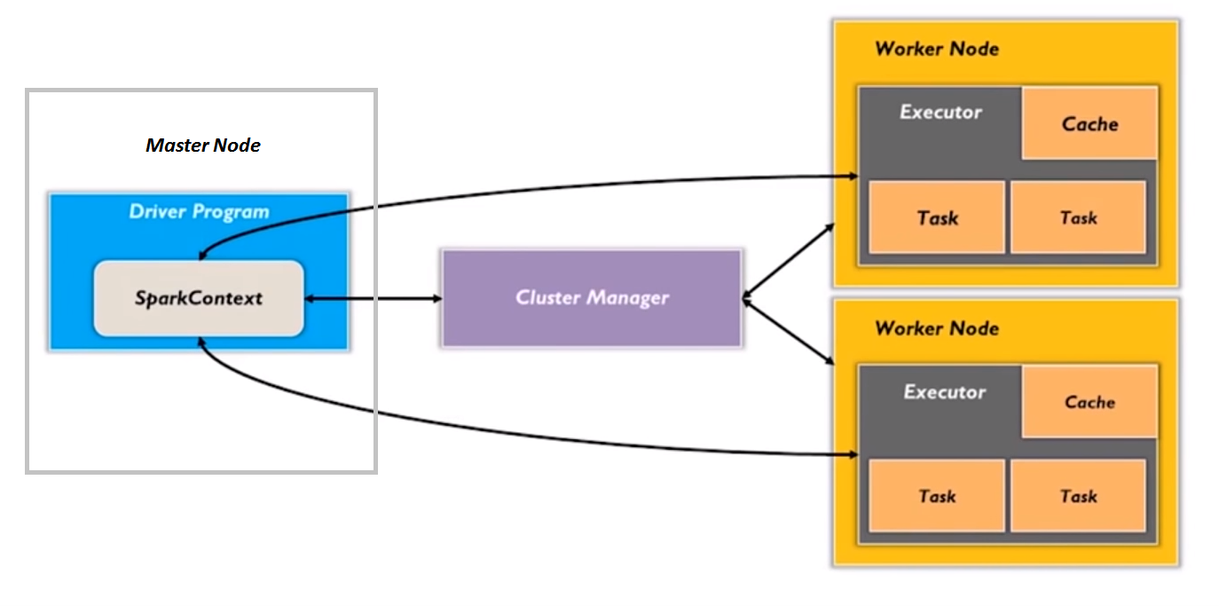



Spark Architecture
Server A
192.168.2.1
Clients
Server B
15 of 21

Slide 17
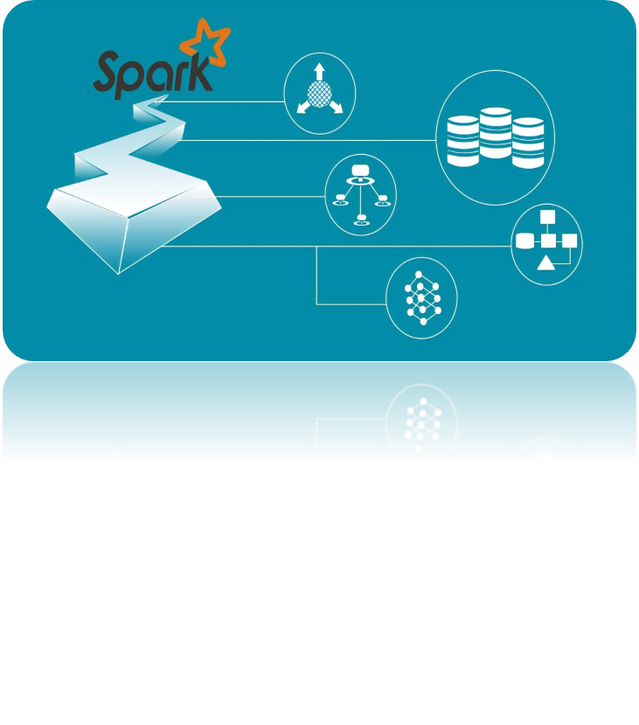
Spark Cluster Managers
Standalone Mode
Mesos
Hadoop YARN
Kubernetes
16 of 21

Slide 18

Applications of Spark
Banking
E-Commerce
Health Care
Entertainment
17 of 21

Slide 19

Spark Use Case
Con viva:
a. Video Streaming
b. Remove Screen Buffering
c. Helps to give better quality
d. Collects data & Give their Customers Visibility
18 of 21

Slide 20
Goals
Apache Spark has its architectural foundation in the resilient distributed dataset (RDD), a read-only multiset of data items distributed over a cluster of machines, that is maintained in a fault-tolerant way.
20 of 21

Slide 21

ANY QS
???
21 of 21

